Slide 1

CAR PRICE PREDICTION
By
K.Naveen Varma

Slide 2
Introduction Of Project:
With the covid 19 impact in the market, we have seen lot of changes in the car market. Now some cars are in demand hence making them costly and some are not in demand hence cheaper. One of our clients works with small traders, who sell used cars. With the change in market due to covid 19 impact, our client is facing problems with their previous car price valuation machine learning models. So, they are looking for new machine learning models from new data. We have to make car price valuation model. This project contains two phase:
Data Collection Phase:
You have to scrape at least 5000 used cars data. You can scrape more data as well, it’s up to you. more the data better the model In this section You need to scrape the data of used cars from websites (Olx, cardekho, Cars24 etc.) You need web scraping for this. You have to fetch data for different locations. The number of columns for data doesn’t have limit, it’s up to you and your creativity. Generally, these columns are Brand, model, variant, manufacturing year, driven kilometers, fuel, number of owners, location and at last target variable Price of the car. This data is to give you a hint about important variables in used car model.

Slide 3
You can make changes to it, you can add or you can remove some columns, it completely depends on the website from which you are fetching the data. Try to include all types of cars in your data for example- SUV, Sedans, Coupe, minivan, Hatchback.
Model Building Phase:
After collecting the data, you need to build a machine learning model. Before model building do all data pre-processing steps. Try different models with different hyper parameters and select the best model. Follow the complete life cycle of data science. Include all the steps like. 1. Data Cleaning 2. Exploratory Data Analysis 3. Data Pre-processing 4. Model Building 5. Model Evaluation 6. Selecting the best model

Slide 4
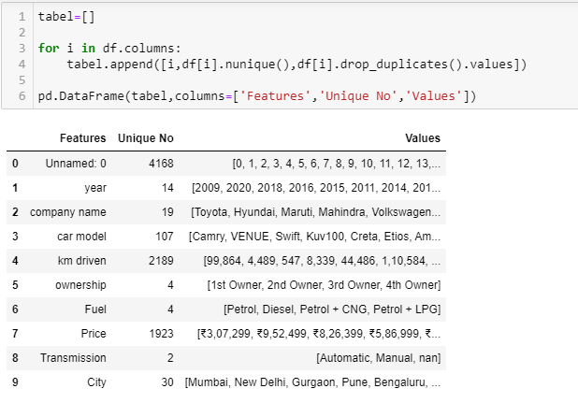
Data Analysis:
The Dataset Contains a Data of 4168 entries each having 11 variables, in which some are numerical Data and some are Categorical Data
Check the info of the data using the info() function
This is about Data set in which I changed the columns to make understandable and data set having one variable is integer remaining all are categorial values.
Next Step is EDA……..(Exploratory Data Analysis)

Slide 5
Exploratory Data Analysis:
In EDA we need to Pre-process the Data and Visualization:
Steps include in Pre-Processing Data are
1)Data Cleaning: - Removing Outliers, Skewness and imputing Missing Values.
2)Data Transformation: - like Normalization by applying normalization we can improve the accuracy and efficiency of the models. And also reduce the errors.
3)Data Reduction: By Reducing the no of features by Feature Selection Process, PCA And VIF
1.Data Cleaning: As a Part of EDA we need to do Data cleaning so firstly we need to check any null values in our data, From the below image shows we don’t have any null values, so no need to impute any data

Slide 6
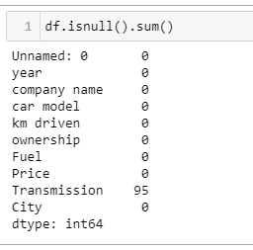
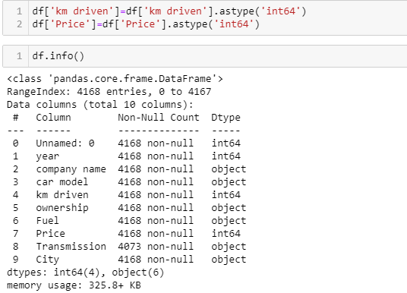
First Step of Data Cleaning is Checking Any null Values in our Data set
For this we used the function
It shows that one of our column having 95 null values need to change by using different methods
In this we are changing the km and price into integer type

Slide 7
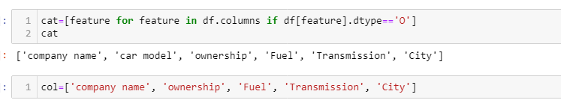
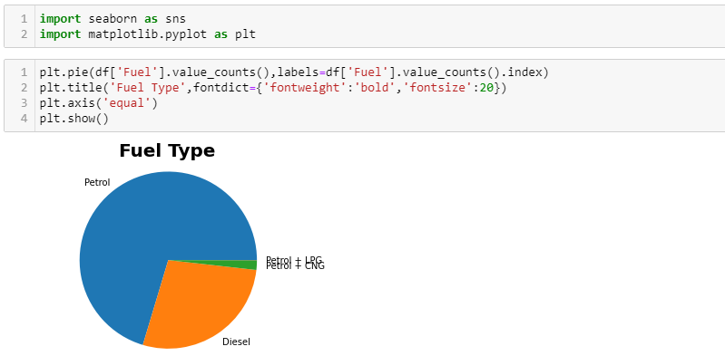
Visualization:
These are the categorical Data types in our Data.
There are different Fuel Types mostly people are okay with the Petrol Cars Compare to other vehicles

Slide 8
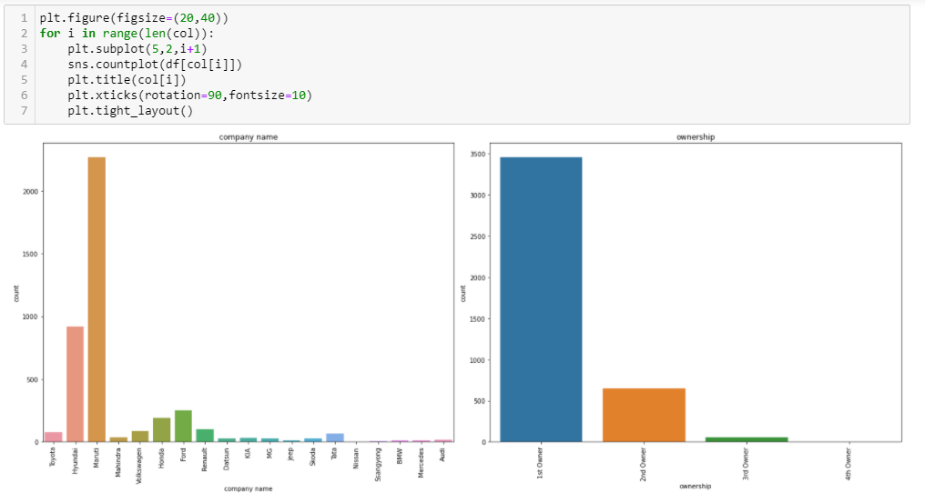
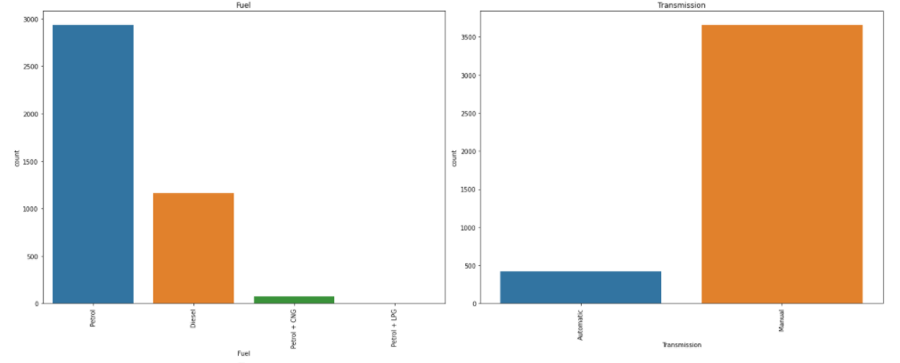
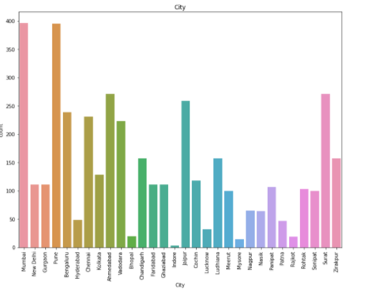
Observation
1)Maruti having high count for sell as compair to otherbrans which means that people who used Maruti's car they sell it fot second Hand. after Maruti, Honda and Hyundai are sell second hand.
2)Most of the cars are from the 1st owner and after that 2nd and 3rd owners.
3)Most of the people are prefere the petrol cars because they have low maintance cost as compair to Diesel and life of petrol car is high than the Diesel car and some people use the Diesel car because they have good mileage.
4)Most os the cars are Manually Transmission and very fews are Automatic.because Automatic having high cost as compair to Manual
5)They are many people from Mumbai,Pune,Jaipur and Surat sell their car and from city like Rajkot,Chennai,Hydrabad ,Indore they are very less for selling the cars.

Slide 9
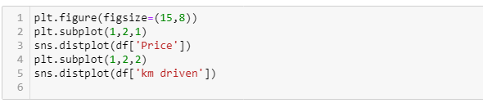
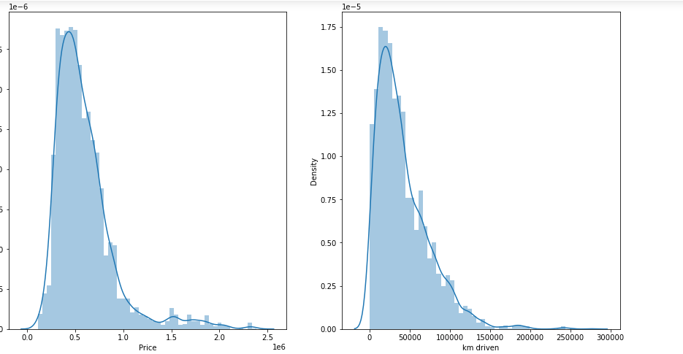
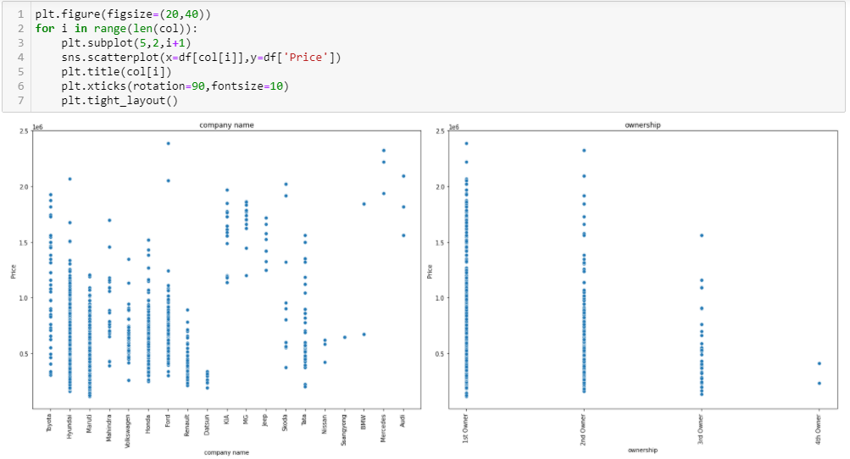
From the charts we know that KM and Price are skewed

Slide 10
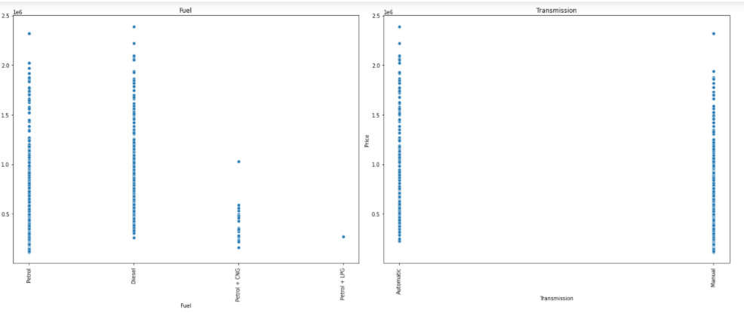
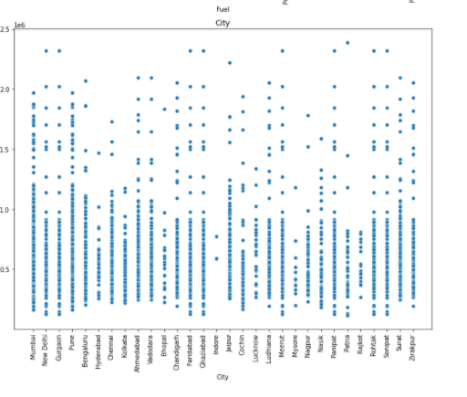
Observation
1)Company like BMW, Audi, Mercedes having high price after that Jeep , KIA are coming for higher price. Maruti ,Toyota ,Honda and Tata having relatively low prices.
2) Price for the 1st owner is high and after than 2nd owner and follow by 3rd and 4th owner. because as the owner changes chances of low milage and maintances cost will increases.
3)price for the petrol is high than petrol+LPG and Petrol+CNG
4) As we earily show that Mumbai, Pune, Surat having high no. of car selling so price is also high for that city as compair to other city like Hyderabad, Mysore, Chennai, Rajkot.

Slide 11
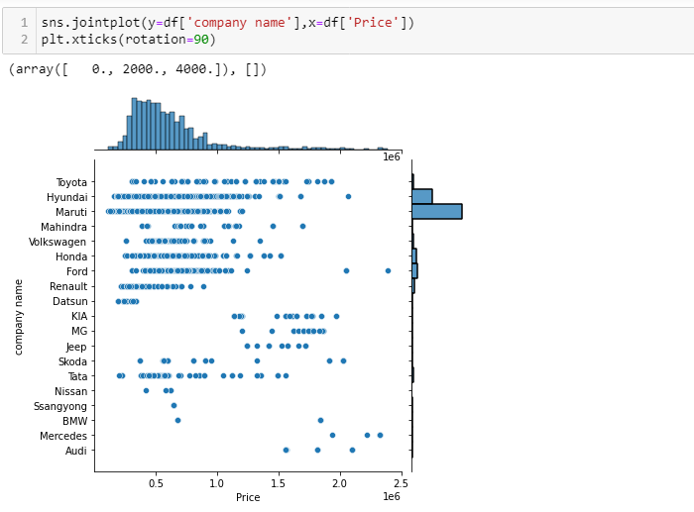
From these chart we can see that Price of the Maruti is low and volume of the Maruti car is high. and price for the Audi ,BMD Mercedes is high and volume is too much low.

Slide 12
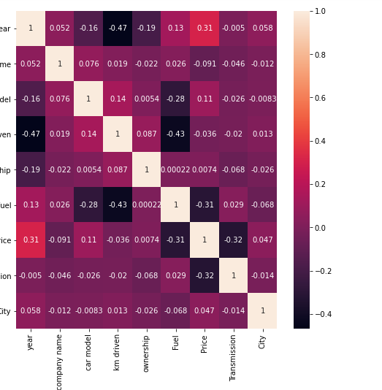
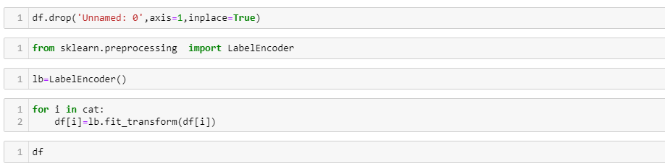
Label Encoding:
Label Encoding is necessary for the data to process to find any outliers are there as of our data consists of both numerical and categorical need to change categorical into numerical values using the encoding methods.
As per the describe analysis, need to drop some more variables to make our model is accurate

Slide 13
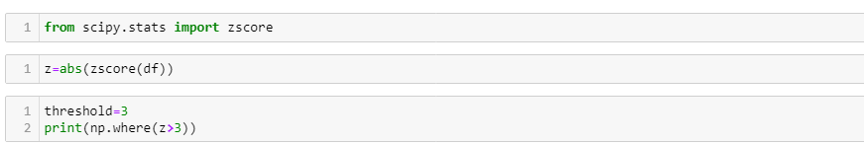
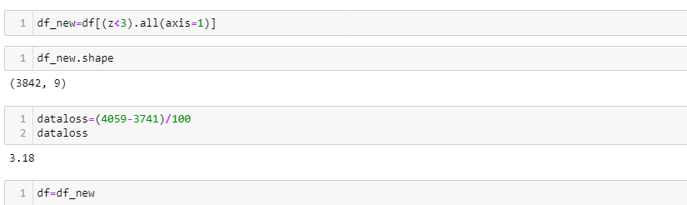
Checking Any Outliers in our Data and Remove it:
It is defined as the points that are far away from the same points.it can be happen because of the variability of the measurements and may be some error also. If possible, outliers should be removed from the datasets. There are servals methos to remove the outliers. 1)Z score 2) Quantile Method (Capping the data)
1)Z Score: it can call from the SciPy. Stats library. And for most of the case threshold values should be used 3.
As above shows our data having the outliers so need to remove outlier by one of the prominent method called z-score method
Almost 3.18% of our train data and 11% of test data is removed

Slide 14
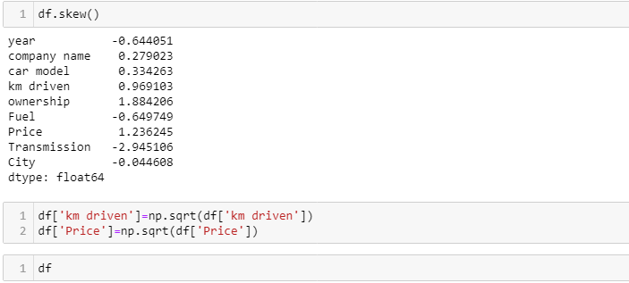
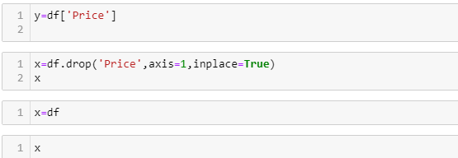
2)Quantile Methods: Inter Quantile Range is used to detect or cap the outliers. Calculate the IQR by scipy.stats.iqr Multiply Interquartile range by 1.5 Add 1.5 x interquartile range to the third quartile. Any number greater than this is a suspected outlier. Subtract 1.5 x interquartile range from the first quartile. Any number lesser than this is a suspected outlier.
Now our Data is ready for modelling as our data is clean so only thing need to do is normalizing the data before need to check our dependent variable .

Slide 15
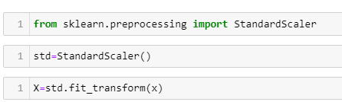
Skewness of Data:
As of our numeric data is skewed we need to do normalization before go for training and testing for that need to check the skewness of data if our data is Greater than 0.5% in both positive and negative sides ,then need to do power transformation and do scaling
Scaling are of two types:
1.Standard Scaler: Standard scalar standardizes features of the data set by scaling to unit variance and removing the mean (optionally) using column summary statistics on the samples in the training set.
MIN-MAX Scaler: MinMaxScaler. For each value in a feature, MinMaxScaler subtracts the minimum value in the feature and then divides by the range. The range is the difference between the original maximum and original minimum. MinMaxScaler preserves the shape of the original distribution.
As we do splitting the data for training and testing the data then now we need to modeling
Try Different Models….

Slide 16
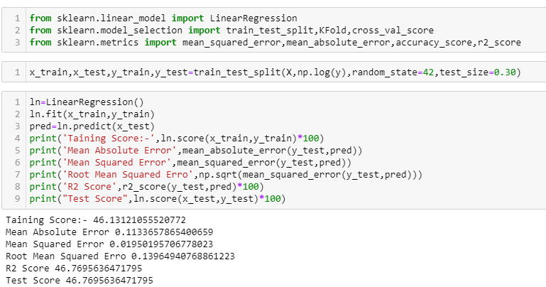
Splitting Data Into train_test_split: -
This function is in sklearn. Model selection splitting the data array into two arrays. Train and Test with this function we don’t need to splitting train and test manually.by default it make random partition and we can also set the random state.it gives four o/p like x_train, x_test, y_train, y_test.

Slide 17
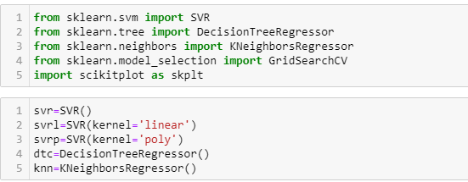
Linear Regression: - Linear regression is a basic and commonly used type of predictive analysis. The overall idea of regression is to examine two things: (1) does a set of predictor variables do a good job in predicting an outcome (dependent) variable? (2) Which variables in particular are significant predictors of the outcome variable, and in what way do they–indicated by the magnitude and sign of the beta estimates–impact the outcome variable? These regression estimates are used to explain the relationship between one dependent variable and one or more independent variables. The simplest form of the regression equation with one dependent and one independent variable is defined by the formula y = c + b*x, where y = estimated dependent variable score, c = constant, b = regression coefficient, and x = score on the independent variable.
I simply used function method, so no need to write the code each and every time, just call the model

Slide 18
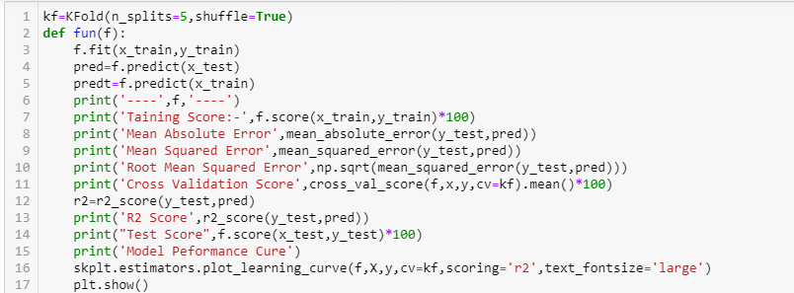
Support Vector Machine: Support Vector Machines (SVM) are popularly and widely used for classification problems in machine learning. I’ve often relied on this not just in machine learning projects but when I want a quick result in a hackathon.
But SVM for regression analysis? I hadn’t even considered the possibility for a while! And even now when I bring up “Support Vector Regression” in front of machine learning beginners, I often get a bemused expression. I understand – most courses and experts don’t even mention Support Vector Regression (SVR) as a machine learning algorithm.

Slide 19
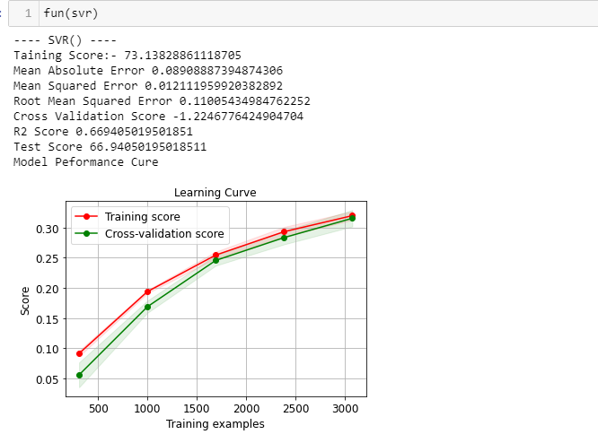
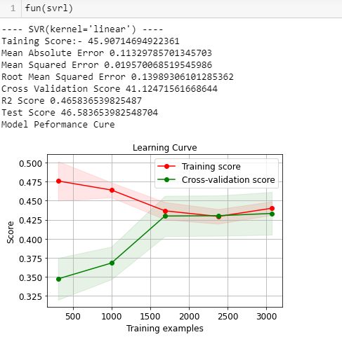
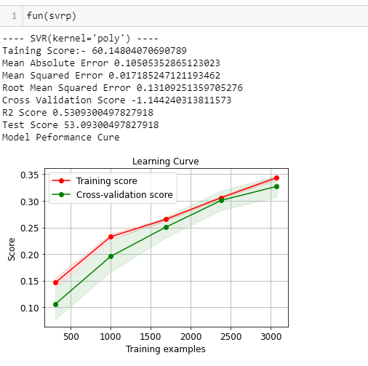

Slide 20
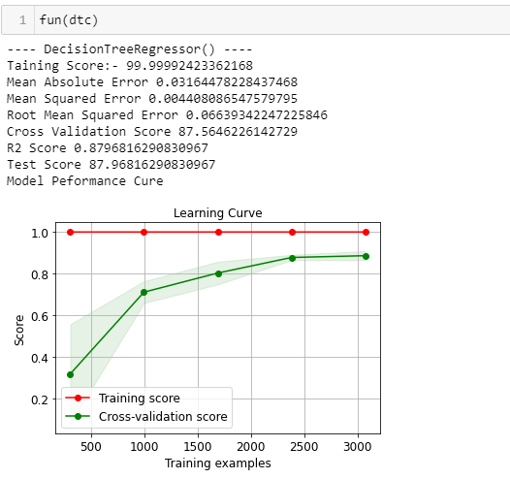
Decision Tree Regression: Decision tree builds regression or classification models in the form of a tree structure. It breaks down a dataset into smaller and smaller subsets while at the same time an associated decision tree is incrementally developed. The final result is a tree with decision nodes and leaf nodes. A decision node (e.g., Outlook) has two or more branches (e.g., Sunny, Overcast and Rainy), each representing values for the attribute tested. Leaf node (e.g., Hours Played) represents a decision on the numerical target. The topmost decision node in a tree which corresponds to the best predictor called root node. Decision trees can handle both categorical and numerical data.

Slide 21
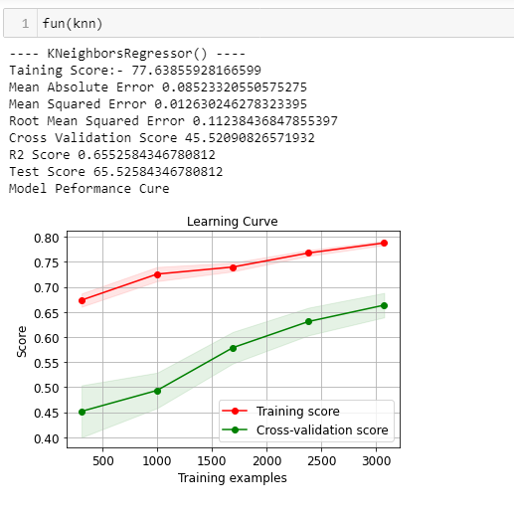
KNN Regressor: KNN regression is a non-parametric method that, in an intuitive manner, approximates the association between independent variables and the continuous outcome by averaging the observations in the same neighbourhood. The size of the neighbourhood needs to be set by the analyst or can be chosen using cross-validation (we will see this later) to select the size that minimizes the mean-squared error.

Slide 22
Lasso Regression: Lasso regression is a regularization technique. It is used over regression methods for a more accurate prediction. This model uses shrinkage. Shrinkage is where data values are shrunk towards a central point as the mean. The lasso procedure encourages simple, sparse models (i.e. models with fewer parameters). This particular type of regression is well-suited for models showing high levels of multicollinearity or when you want to automate certain parts of model selection, like variable selection/parameter elimination.
Lasso Regression uses L1 regularization technique (will be discussed later in this article). It is used when we have more number of features because it automatically performs feature selection.
2) Ridge Regression: Ridge regression is a model tuning method that is used to analyse any data that suffers from multicollinearity. This method performs L2 regularization. When the issue of multicollinearity occurs, least-squares are unbiased, and variances are large, this results in predicted values to be far away from the actual values.

Slide 23
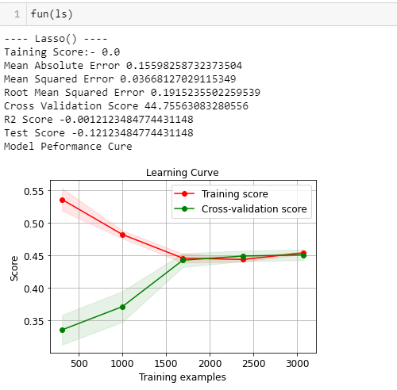
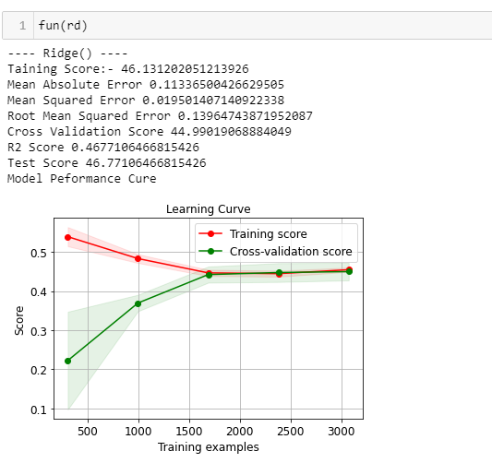
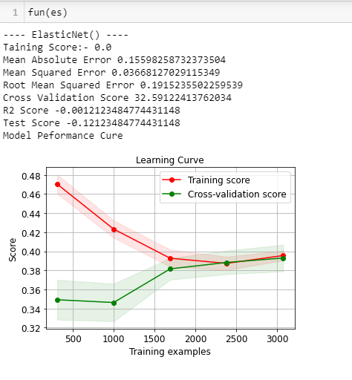

Slide 24
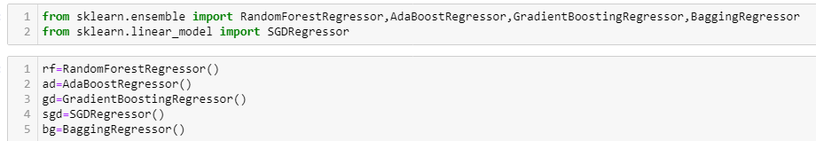
Random Forest Regression: Random forest is a supervised learning algorithm. The "forest" it builds, is an ensemble of decision trees, usually trained with the “bagging” method. The general idea of the bagging method is that a combination of learning models increases the overall result.
Random forest has nearly the same hyperparameters as a decision tree or a bagging classifier. Fortunately, there's no need to combine a decision tree with a bagging classifier because you can easily use the classifier-class of random forest. With random forest, you can also deal with regression tasks by using the algorithm's regressor.

Slide 25
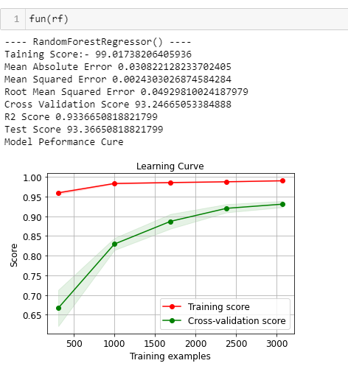
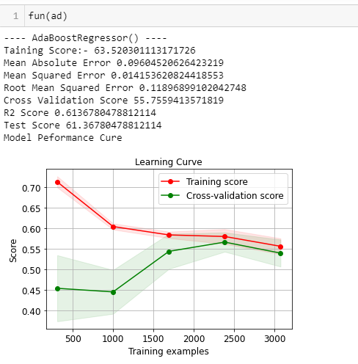
Ada Boost Regression: An AdaBoost regressor is a meta-estimator that begins by fitting a regressor on the original dataset and then fits additional copies of the regressor on the same dataset but where the weights of instances are adjusted according to the error of the current prediction. As such, subsequent regressors focus more on difficult cases.

Slide 26
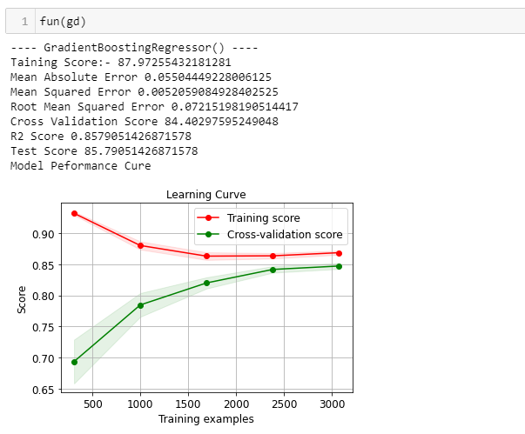
Gradient Boost Regressor: Gradient boosting is a type of machine learning boosting. It relies on the intuition that the best possible next model, when combined with previous models, minimizes the overall prediction error. The key idea is to set the target outcomes for this next model in order to minimize the error.

Slide 27
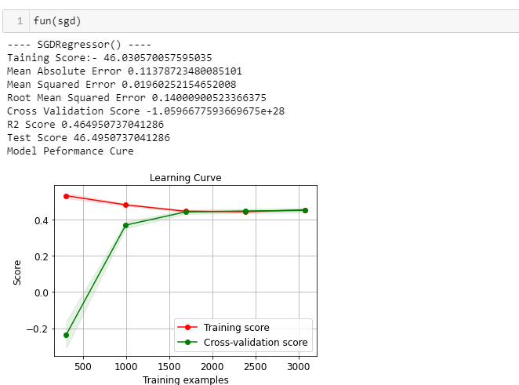
Stochastic Gradient Regressor: Stochastic Gradient Descent (SGD) regressor basically implements a plain SGD learning routine supporting various loss functions and penalties to fit linear regression models. Scikit-learn provides SGDRegressor module to implement SGD regression.

Slide 28
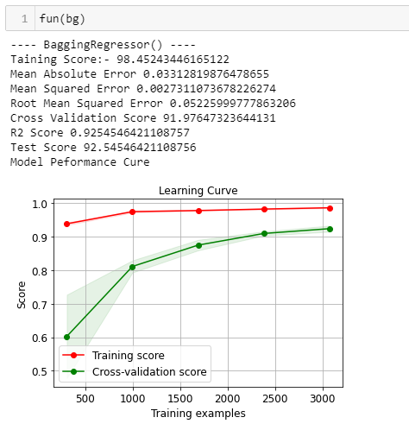
Baggage Regressor:
A Bagging regressor. A Bagging regressor is an ensemble meta-estimator that fits base regressors each on random subsets of the original dataset and then aggregate their individual predictions (either by voting or by averaging) to form a final prediction. ... The base estimator to fit on random subsets of the dataset.

Slide 29
Now Lets Discuss About each variable in output:
Mean Absolute Error: In statistics, mean absolute error (MAE) is a measure of errors between paired observations expressing the same phenomenon. ... This is known as a scale-dependent accuracy measure and therefore cannot be used to make comparisons between series using different scales.
Mean Squared Error: Mean Squared Error (MSD) of an estimator measures the average of error squares i.e. the average squared difference between the estimated values and true value. It is a risk function, corresponding to the expected value of the squared error loss. It is always non – negative and values close to zero are better. The MSE is the second moment of the error (about the origin) and thus incorporates both the variance of the estimator and its bias.
R2_score: Coefficient of determination also called as R² score is used to evaluate the performance of a linear regression model. It is the amount of the variation in the output dependent attribute which is predictable from the input independent variable(s). It is used to check how well-observed results are reproduced by the model, depending on the ratio of total deviation of results described by the model.

Slide 30
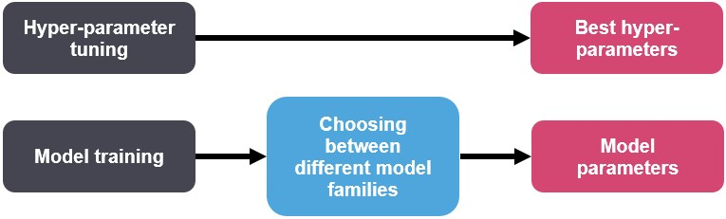
Cross Validation: - This technique is used to check weather out data set is over fitting or under fitting. If model score is high and cv score is less it means model perform well in train dataset but did not perform well in unseen or test dataset. Feature selection is the best way to overcome the overfitting problem. There are 3 ways for the validation. KFold Cross validation score, Hold Out Methods and LOOCV.
Hyper Tuning Method:
Hyper-parameters: Model parameters are learned from data and hyper-parameters are tuned to get the best fit. Searching for the best hyper-parameter can be tedious, hence search algorithms like grid search and random search are used.

Slide 31
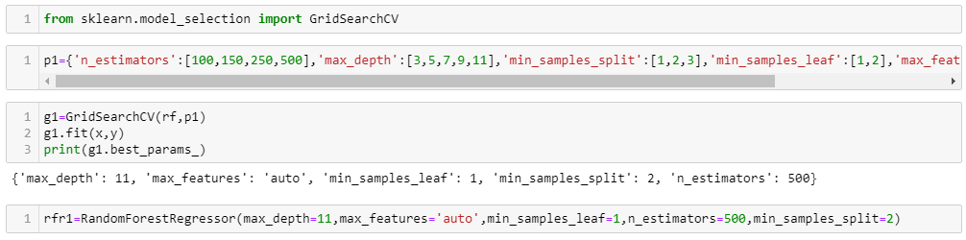
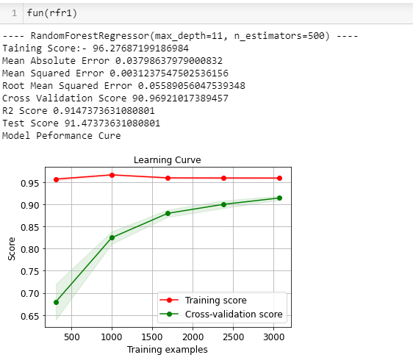
Concluding Remarks: - From this model we can predict the Car price prediction of different variables how the prices are varying according to that each one can take their prescribed house.
We used different regression methods to test the process of the model like Linear Regression, Decision tree Regression, Lasso Regression, Ridge Regression and Ada boosting Regression, Random Forest Regression, Gradient Regression, SGD Regression .
We get good score in Ridge Regressor got r2_score of 96.27% on training data, mean absolute error is 3.79% , Diff Between score and validation score also nice but not in 1st position but comparatively with all the variables and cross validation value also is high in Random Forest Regressor .the model performance is excellent.

Slide 32


